Slide 1

ANALYSIS OF AUTHORSHIP IN ARABIC SOURCES
Mayar Salih & Bolos Khoury
25-2-R-7
Supervisors: Prof. Zeev Volkovich & Dr. Renata Avros
1

Slide 2
1
Introduction
2

Slide 3
ANALYSIS OF AUTHORSHIP IN ARABIC SOURCES
Key Challenges
Classical Arabic texts often have uncertain authorship.
Limited computational tools for Arabic vs. manual analysis.
Research Importance
Resolves historical text disputes.
Enables data-driven authorship analysis in Arabic NLP.
Authorship Attribution
Goal: Verify authorship using linguistic and stylistic patterns.
3

Slide 4
Arabic Language Challenges
Morphological Richness
Orthographic Variability
Root-based word formation Extensive prefix/suffix combinations Example: ״ من + كتاب + ها → from her book"
Multiple form:
أ، إ، آ → ا
Diacritic inconsistency Historical spelling variations
Syntactic Flexibility
Limited Resources
Flexible word order (VSO, SVO)
Context-dependent meanings
Fewer pre-trained models compared to English Sparse labeled datasets for classical texts
4

Slide 5
Existing Solutions
Current Arabic Authorship Research
Limitations of Existing Approaches
AlZahrani & Al-Yahya (2023): ARBERT + AraELECTRA → 96% accuracy on Islamic legal texts
Alqurashi et al. (2025): BERT + topic modeling → F1: 0.97-1.0 on Arabic poetry
Howedi et al. (2020): Stylometric features + KNN → 90% accuracy on historical texts
Most focus on closed-set attribution (limited author pool)
Lack adaptability to classical Arabic characteristics
Limited handling of stylistic variation and historical depth
5

Slide 6
Deep Impostors Method
Identified pseudo-Shakespearean works Achieved consistent clustering over 127 classifier iterations
Volkovich & Avros: Successfully applied Deep Impostors to Shakespearean texts
Inspiration from Supervisors' Work
Application of Deep Impostors to Arabic literature
Accounts for Arabic's morphological complexity
Handles right-to-left text structure
Addresses diacritic variability
Our Adaptation to Arabic
6

Slide 7
Deep Impostors Methodology
Core Concept: Transform authorship verification into signal comparison problem
Divide texts into batches of L words
01
Select impostor pairs (Zi, Zj) from different authors
02
Train binary classifier to distinguish between impostors
03
Apply classifier to test document → binary sequence {0,1,1,...}
04
Aggregate results into real-valued signal components
05
7

Slide 8
2
Proposed Solution
8

Slide 9
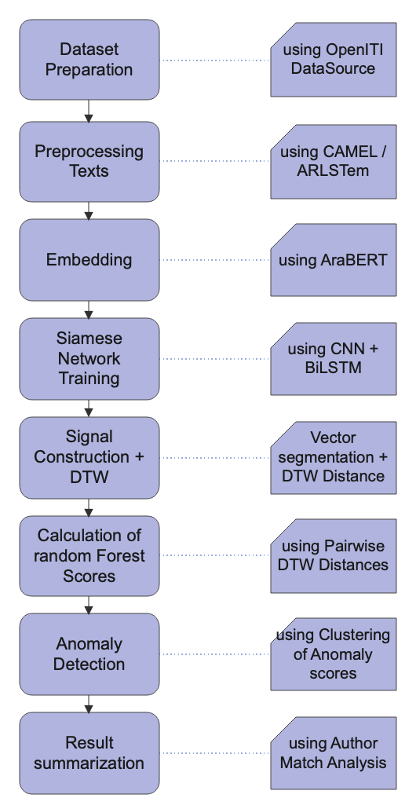
System Architecture Overview
Workflow Diagram
9

Slide 10

Stage 1 - Dataset Preparation
Dataset Structure
Target Set: Texts by one known Arabic author (for testing)
Impostor Set: Texts by other authors from similar contexts
Data Sources
OpenITI (Open Islamic Texts Initiative)
Al-Maktaba al-Shamilah
Quality Assurance
Stylistic balance across document length and genre
Historical period consistency
Verified authorship for training data
Similar subject matters to prevent topic-based classification
10

Slide 11
Stage 2 - Arabic Text Preprocessing
Step 1 | Original Text | إنَّ الكِتابَةَ فَنٌّ عَظيمٌ يَحتاجُ إلى مَهارَةٍ وَصَبْرٍ
Step 2 | Tokenization | ["إنَّ", "الكِتابَةَ", "فَنٌّ", "عَظيمٌ", "يَحتاجُ", "إلى", "مَهارَةٍ", "وَ", "صَبْرٍ"]
Step 3 | Stopword Removal | ["إنَّ", "الكِتابَةَ", "فَنٌّ", "عَظيمٌ", "يَحتاجُ", "مَهارَةٍ", "صَبْرٍ"]
Step 4 | Normalization | ["ان", "الكتابه", "فن", "عظيم", "يحتاج", "مهاره", "صبر"]
Step 5 | Light Stemming | ["ان", "كتاب", "فن", "عظيم", "حتاج", "مهار", "صبر"]
11

Slide 12
Stage 3 - AraBERT Embedding (Post Training)
Converting Arabic to Numerical Vectors
Token limit constraints require text segmentation into manageable chunks
Subword tokenization handles rare and unseen Arabic words effectively
Overlapping segments preserve contextual information across boundaries
Input Processing
Token-level vectors: High-dimensional contextual embeddings
Sequence representation: Dense matrices capturing linguistic patterns
Rich linguistic encoding: Semantics, syntax, and stylistic cues
Embedding Extraction Strategy
5 | 4 | 1 | -2 | 3
Output: High-dimensional vectors encoding Arabic stylistic features
12

Slide 13

Stage 4 - Siamese Network Training
Twin Network Structure:
Two identical subnetworks with shared weights
Parallel processing of text pair inputs
Learned similarity measurement
Network Components: CNN Layers → Detect local stylistic patterns:
Syntactic constructions
Characteristic Arabic phrasing
Morphological markers
BiLSTM Layers → Capture long-range dependencies:
Stylistic flow across text
Arabic flexible word order handling
13

Slide 14
Stage 5 - Signal Construction & DTW
Signal Creation Process:
Sequential text chunking of document
Similarity scoring against reference chunks
One-dimensional signal representing stylistic consistency
Dynamic Time Warping (DTW) :
Compares signals of different texts, even if they vary in length or structure.
Finds the optimal alignment between stylistic patterns.
Robust to order and pacing differences.
Result: Stylistic signals comparable across different document structures
14

Slide 15
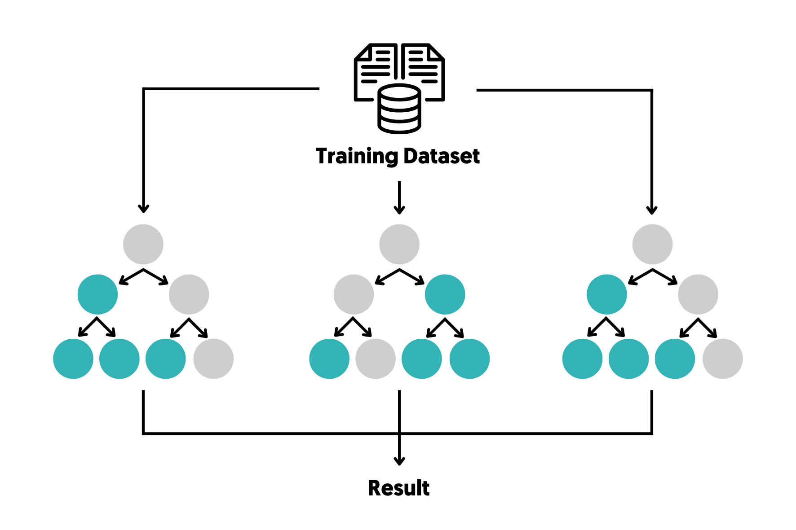
Stage 6 - Calculation of Random Forest Scores
After computing DTW distances between pairs of text signals, we use these distances to build a feature space.
Each comparison (target vs. impostor text) is represented by its DTW based similarity profile.
We feed these features into a Random Forest classifier, a robust ensemble machine learning model.
What the Random Forest Does: it analyzes multiple decision trees to estimate the probability that two texts were written by the same author.
It handles noisy features and avoids overfitting, important for real-world, messy Arabic texts.
Why This Step Matters: Converts raw DTW distances into a meaningful authorship similarity score.
Helps bridge the gap between raw signal similarity and higher-level authorship prediction.
15

Slide 16
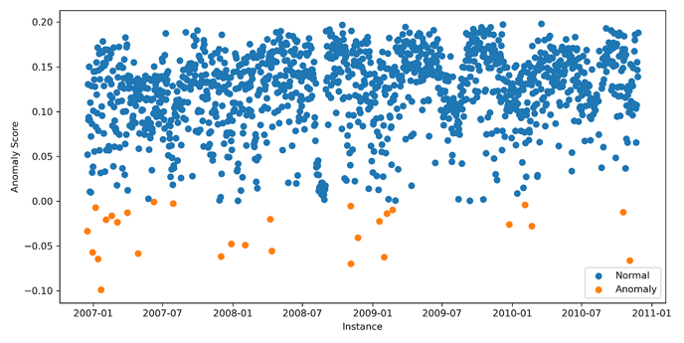
Stage 7 - Anomaly Detection
Final Verification Through Dual Methods
Method 1: Isolation Forest Principle: Outliers require fewer tree splits to isolate
Anomaly Score Calculation:
Score ≈ 1: Strong outlier (impostor text)
Score ≈ 0.5: Normal pattern (authentic text)
Method 2: K-Means Clustering (k=2)
Group documents by stylistic signal similarity
Validate Isolation Forest results
High confidence when both methods agree
Decision Logic:
Authentic texts: Hard to isolate, cluster together
Impostor texts: Easy to isolate, form separate cluster
Isolation forest example
16

Slide 17

Summary & Results
The results we aim to get:
Develop a deep learning framework for Arabic authorship verification.
Combined AraBERT, Siamese Network, DTW, and Isolation Forest.
Successfully distinguished authentic texts from impostors.
Clustering showed consistent author style grouping.
Validated effectiveness on Arabic texts.
17

Slide 18
3
Evaluation Plan
18

Slide 19
Evaluation Plan
Test No. | Test Subject | Expected Result
1 | Validate tokenization and normalization: Test Arabic text splitting and standardization. | Accurate and consistent segmentation and formatting of text across the dataset.
2 | Verify stopword removal and stemming: Ensure reduction of uninformative content while preserving key lexical features. | Text retains core meaning and stylistic elements, reducing dimensionality.
3 | Assess AraBERT embeddings: Evaluate the semantic and stylistic representation of text segments. | High-quality embeddings that differentiate writing styles effectively.
4 | Evaluate similarity scoring with Siamese Network: Test how well the model distinguishes between similar and dissimilar text pairs. | Lower distance for same-author pairs; higher distance for different authors.
5 | Test robustness to noisy input: Introduce variations like typos or missing chunks. | Minimal accuracy drop; model remains stable under imperfect input.
6 | Validate signal representation and DTW alignment: Examine the numeric representation of style and its distance comparison. | Signal distances reflect meaningful stylistic similarity or difference.
7 | Evaluate clustering: Group texts based on similarity using Isolation Forest and k-means. | Clear and interpretable clustering that aligns with author boundaries.
8 | Run end-to-end system test: Assess the framework's full pipeline from raw input to classification. | Consistent and accurate authorship attribution across multiple text cases.
19

Slide 20
Thank You!
Visit our GitHub repo at : CapstoneProject
20

